Slide 1


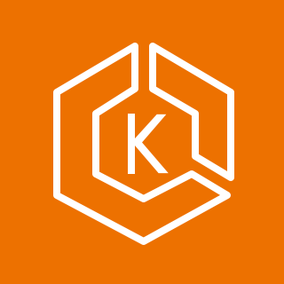
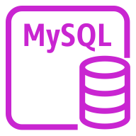
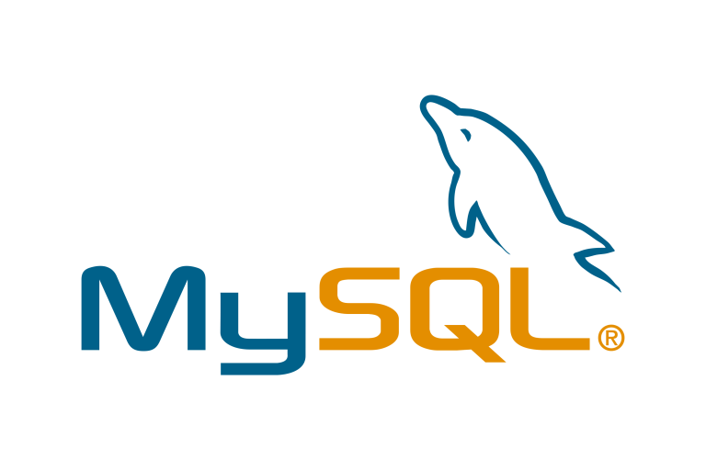



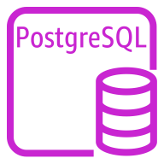


DEMO Architecture
Collect Metrics
Aurora MySQL Cluster
EKS Cluster
Query & Collect Metrics
Discover & Scrap
Metrics
CloudWatch
Aurora MySQL One
/ Writer
Query Metrics
MySQLd Exporter
/ Writer
Write Metrics
(Prometheus
Remote Write)
Aurora MySQL Two
/ Reader
MySQLd Exporter
/ Reader
ADOT
Collector
Aurora Postgres
Cluster
AMP
Postgres Exporter
/ Writer
ADOT
Collector
Query Metrics
Aurora PostgreSQL One
/ Writer
Request
Dashboards
Postgres Exporter
/ Reader
Aurora PostgreSQL Two
/ Reader
Grafana
Client
Notes:
AWS Device Farm is an app testing service that lets you test and interact with your Android, iOS, and web apps on many devices at once, or reproduce issues on a device in real time. View video, screenshots, logs, and performance data to pinpoint and fix issues and increase quality on real consumer devices, the same devices that your users are facing, before shipping your app. Device Farm solves two major testing formats – Manual Testing of applications, and Automated testing of your application on multiple devices simultaneously, all on the same real devices that your users use.

